Slide 1
Analysis of NHIS DATA and building associated software components
Ankitha Kumari Moodukudru
Deepanshu Parihar
Harish Ramani
Viral Pandey

Slide 2
Contents
Our Objectives
Brief Outcomes

Slide 3
About NHIS
A survey conducted annually by the US Census Bureau for Center of Disease control and prevention
Data is collected from a selected sample of households in US by conducting face to face interviews
Collects demographic information, health status and limitations, injuries, healthcare access and utilization, health insurance, income and assets
Primary source of health information in US
Distributed across 6 data files – Adult, person, child, injury episode, family and household

Slide 4
Effect of Yoga and Meditation on Behavioral health
As per the 2017 NHIS survey
Nearly 16% of the US population engaged in different forms of meditation.
Around 15% practiced Yoga on a regular basis.
Based on the self report of feelings as reported a month prior to the interview :
24% of the US adult population has ever felt nervous/fidgety
9% of the US adult population felt hopeless/Worthless
There are numerous studies on how meditation or yoga affects our day to day health and contributes to emotional well being. Hence we wanted to explore this relationship with the data in hand.

Slide 5
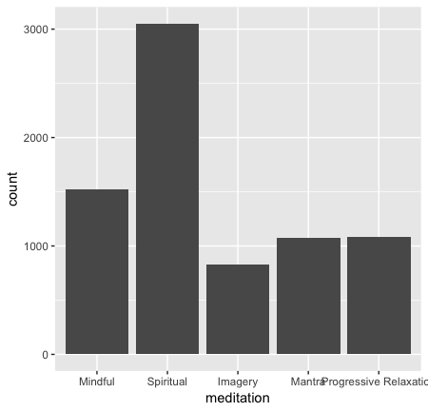
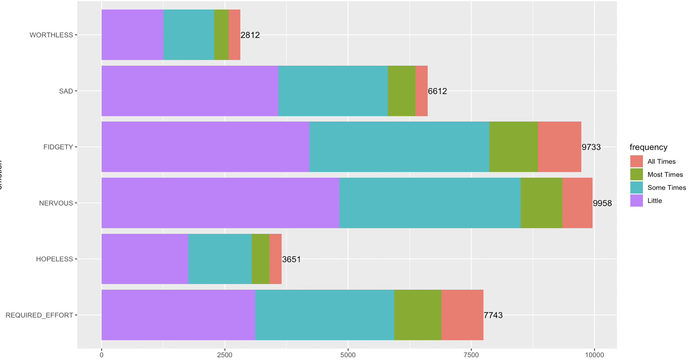

Slide 6
Methods
6 Variables representing different feelings:
Sad, Nervous, Fidgety, Hopeless, Worthless and Required effort
and each of them had 5 levels that represented how often the participant felt these feelings
In order to favor the analysis, we combined these variables into a single “negative emotion score”
The negative emotion score is an average of the score for 6 feelings and ranges from 0 to 1
A score of 1 meant serious psychological distress
We compared the score against the part of the population practicing Yoga and meditation separately.

Slide 7
Sad, Nervous, Fidgety, Worthless, Hopeless, Everything required effort
All the time
1
Most of the times
2
Some times
3
Little of the time
4
Never
5
Abs(Sum(scores))/24
Negative emotion score
0 - 1

Slide 8
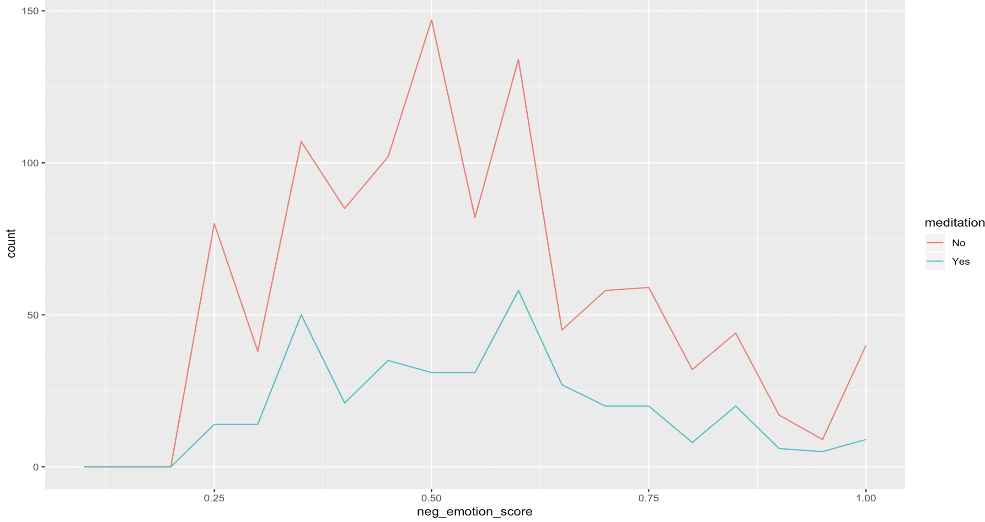
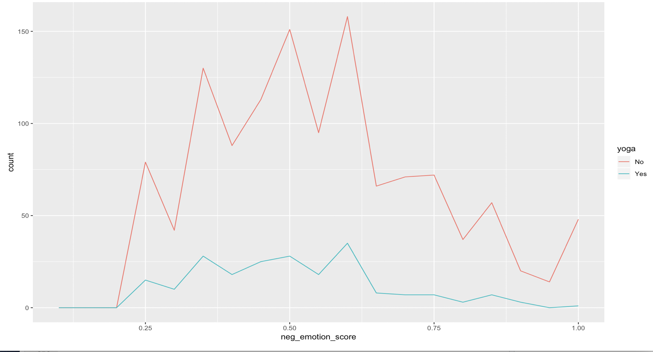
Emotion score vs Yoga and Meditation

Slide 9
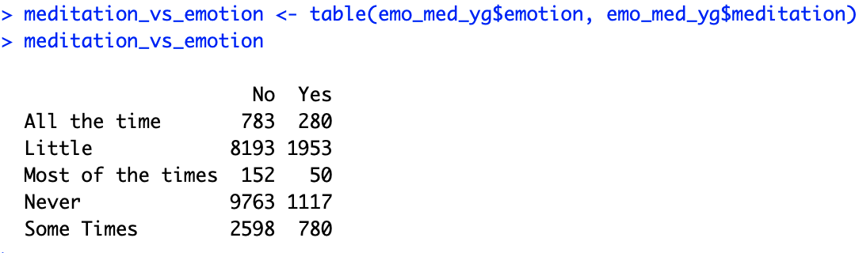
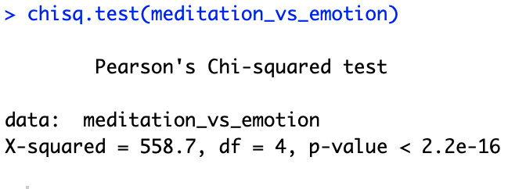
Inference
The relative frequencies show that the number of participants experiencing negative emotions is higher
in the non yoga/meditation practicing population
However this does not confirm the effect of practicing yoga/meditation on behavioral health.
In order to verify if there is a relationship between these factors and the emotional well being,
we employed chi – square test of independence.
Emotion representing the overall frequency of self reported feelings
Similar results were observed with yoga.
A very low p-value determines that the frequency of these feelings and practicing yoga/meditation are dependent.

Slide 10
CHALLENGES/FUTURE WORK
In order to further understand the effect, we need to design an experiment targeted at how often they have been
practicing meditation/yoga and also track their feelings over a period of time.
An additional question can also be added to the questionnaire regarding the duration for which they have
engaged in yoga/meditation.

Slide 11
Effect of different habits, statuses and other life choices on sleep
As per the 2017 NHIS survey
Around 62% of the US population sleeps for 7 to 9 hours
Approximately 14% sleeps unhealthy amounts of hours
We wanted to see if there was any correlation between sleep and different factors like smoking & alcohol habits, annual income, health status, debt, medical conditions, no. of jobs etc

Slide 12
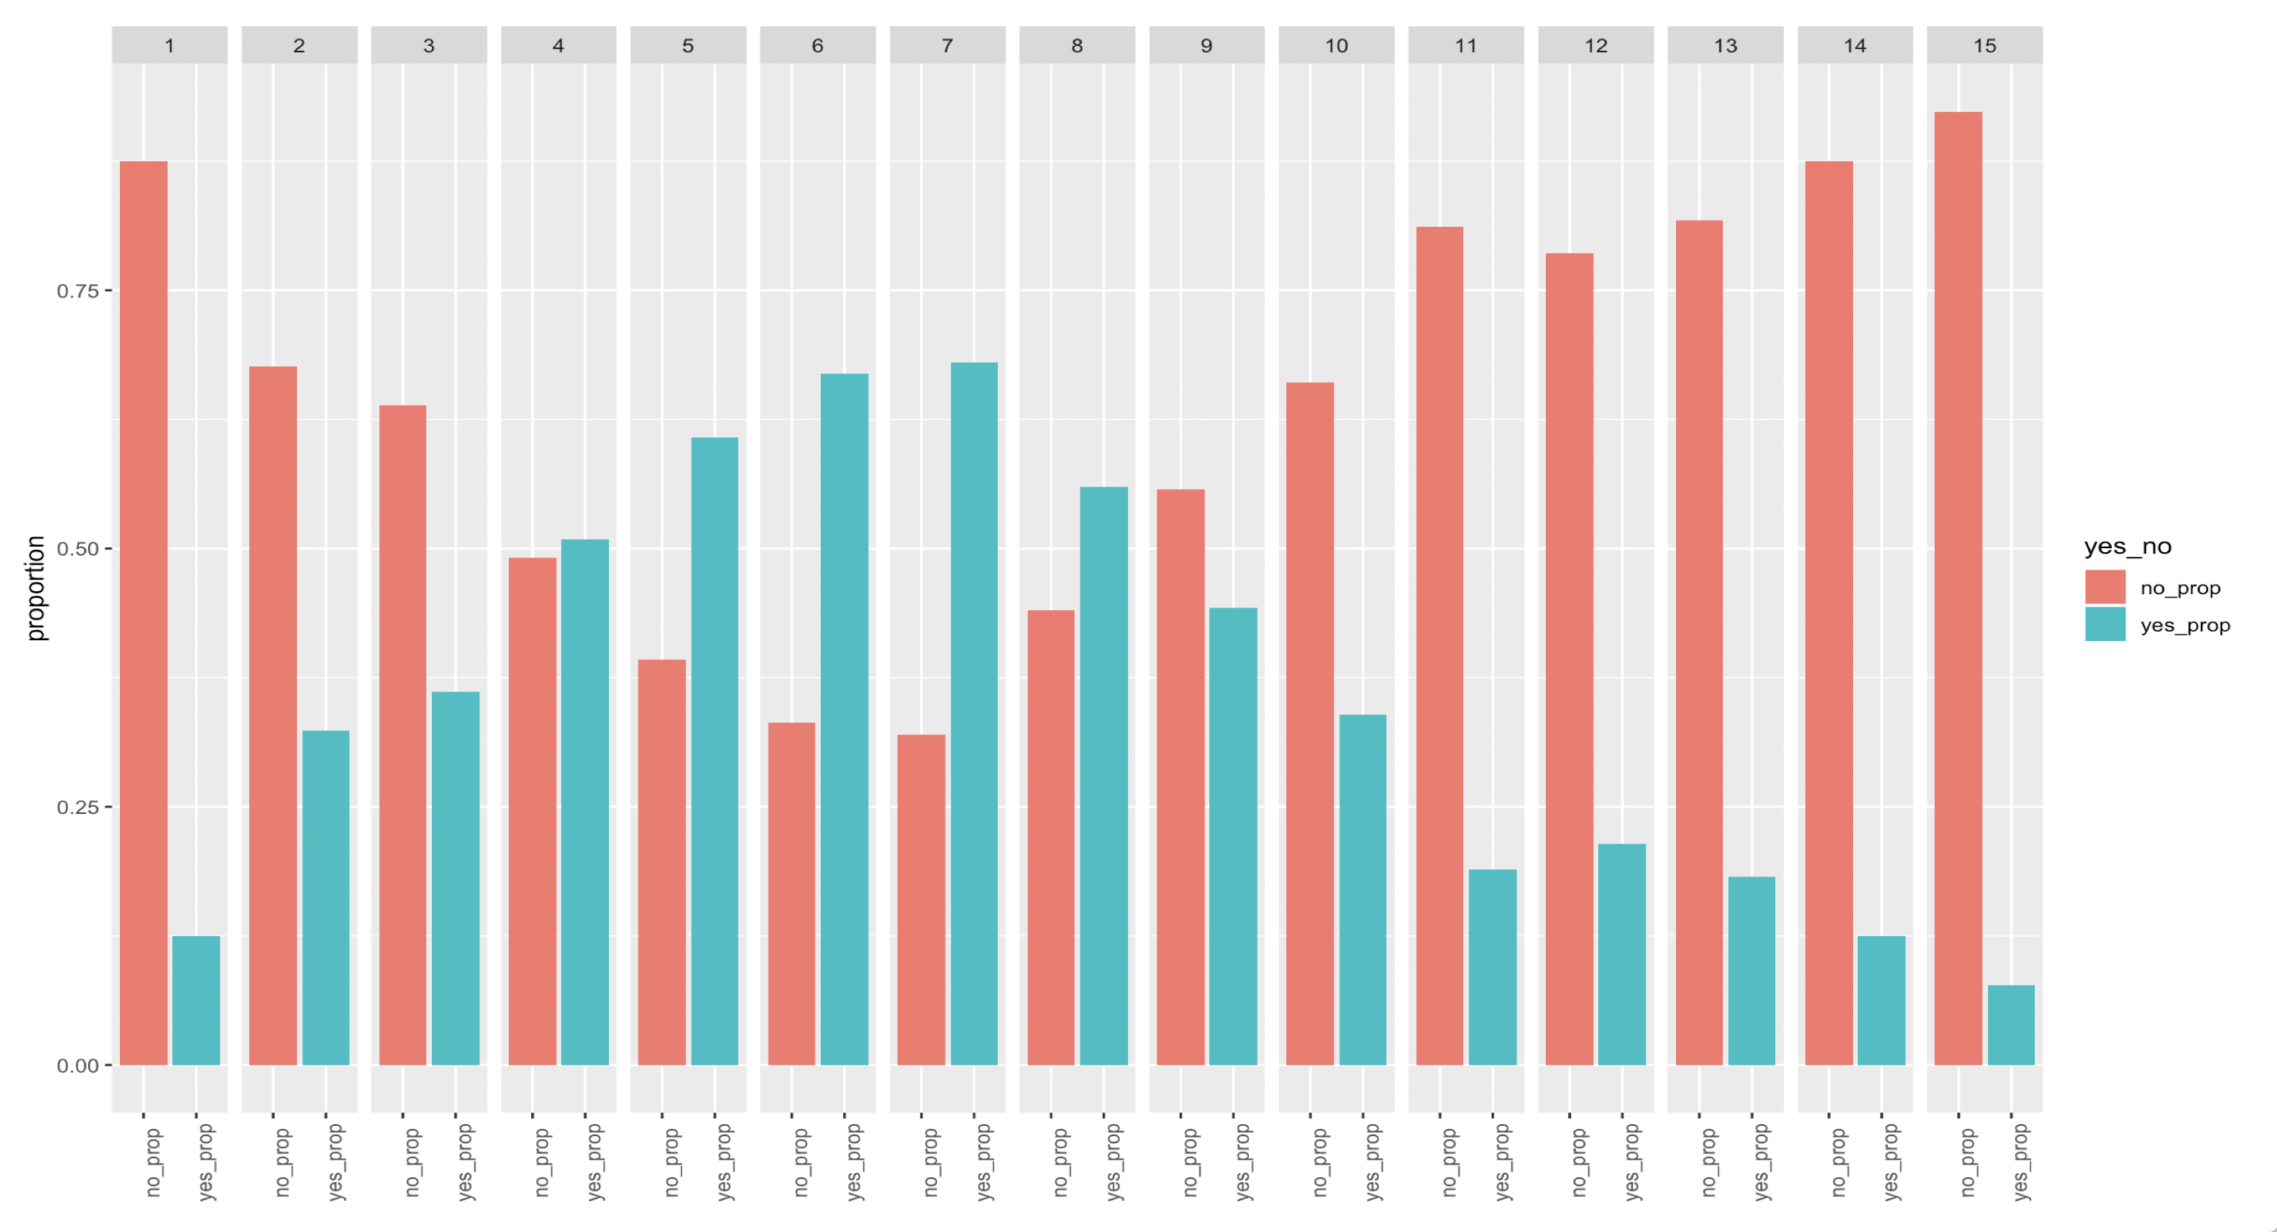
Whether a person has income from regular wages or salary
YES / NO
Proportion of people

Slide 13
Methods
5 Variables representing sleeping pattern of an individual: Number of hours of sleep, Number of days woke up feeling rested in past week, Number of times having trouble falling asleep in past week, Number of times taking medication for sleep in past week, Number of times having trouble staying asleep in past week
In order to favor the analysis, we combined these variables into a single “Sleep score”
Sleep score ranges from 0 to 100 where the person with better score sleeps better

Slide 14
Computing Sleep score
Number of Hours of sleep
Score += 10 - 40
Days woke up feeling rested, past week
Score += 0 - 20
Score
=
0
# times having trouble falling asleep, past week
Score
=
0 - 100
Score += 0 - 10
# times taking medication for sleep, past week
Score += 0 - 20
# times having trouble staying asleep, past week
Score += 0 - 10

Slide 15
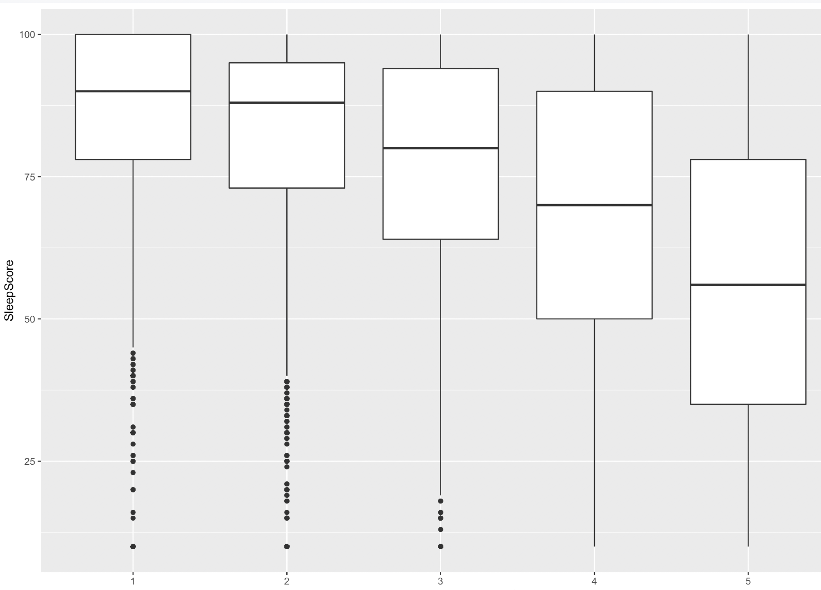
How would you describe your health in general?
Sleep Score
Good
Fair
Poor
Excellent
Very Good

Slide 16
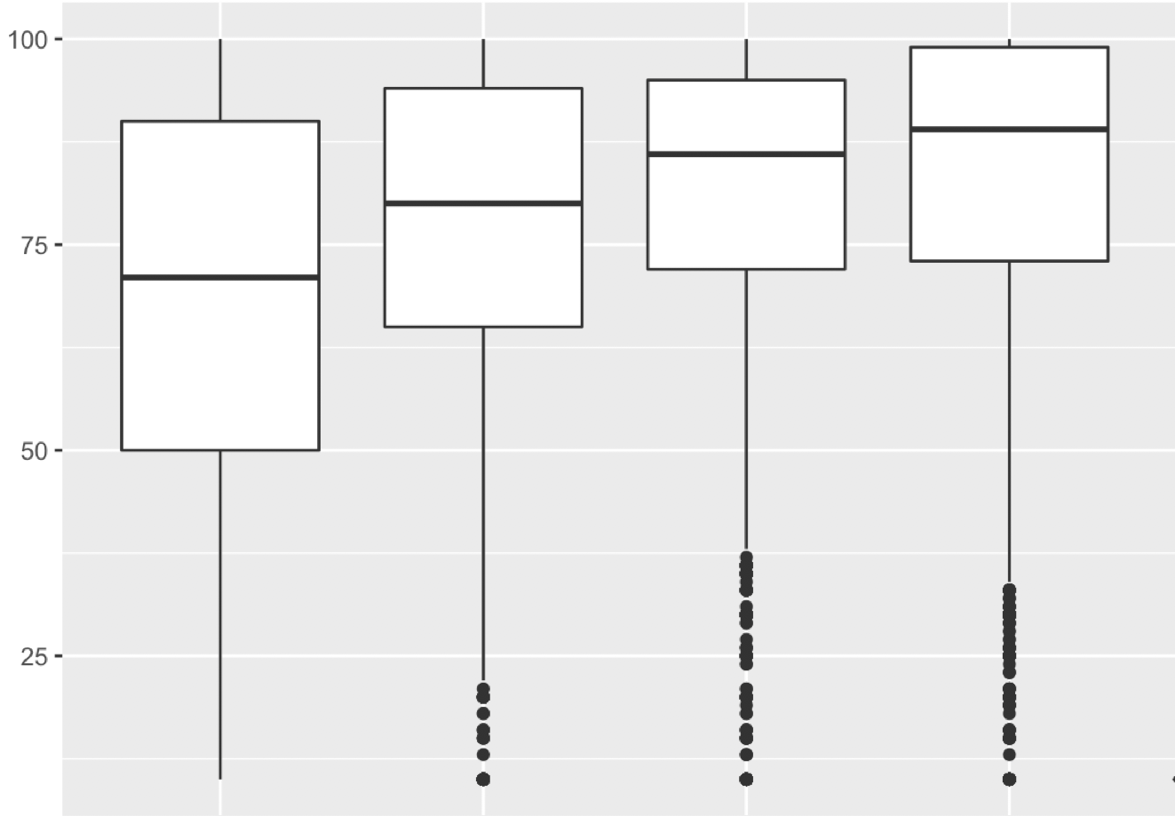
How worried are you right now about not being able to pay medical costs for normal healthcare?
Sleep Score
Very worried
Moderaterly worried
Not too worried
Not worried at all

Slide 17
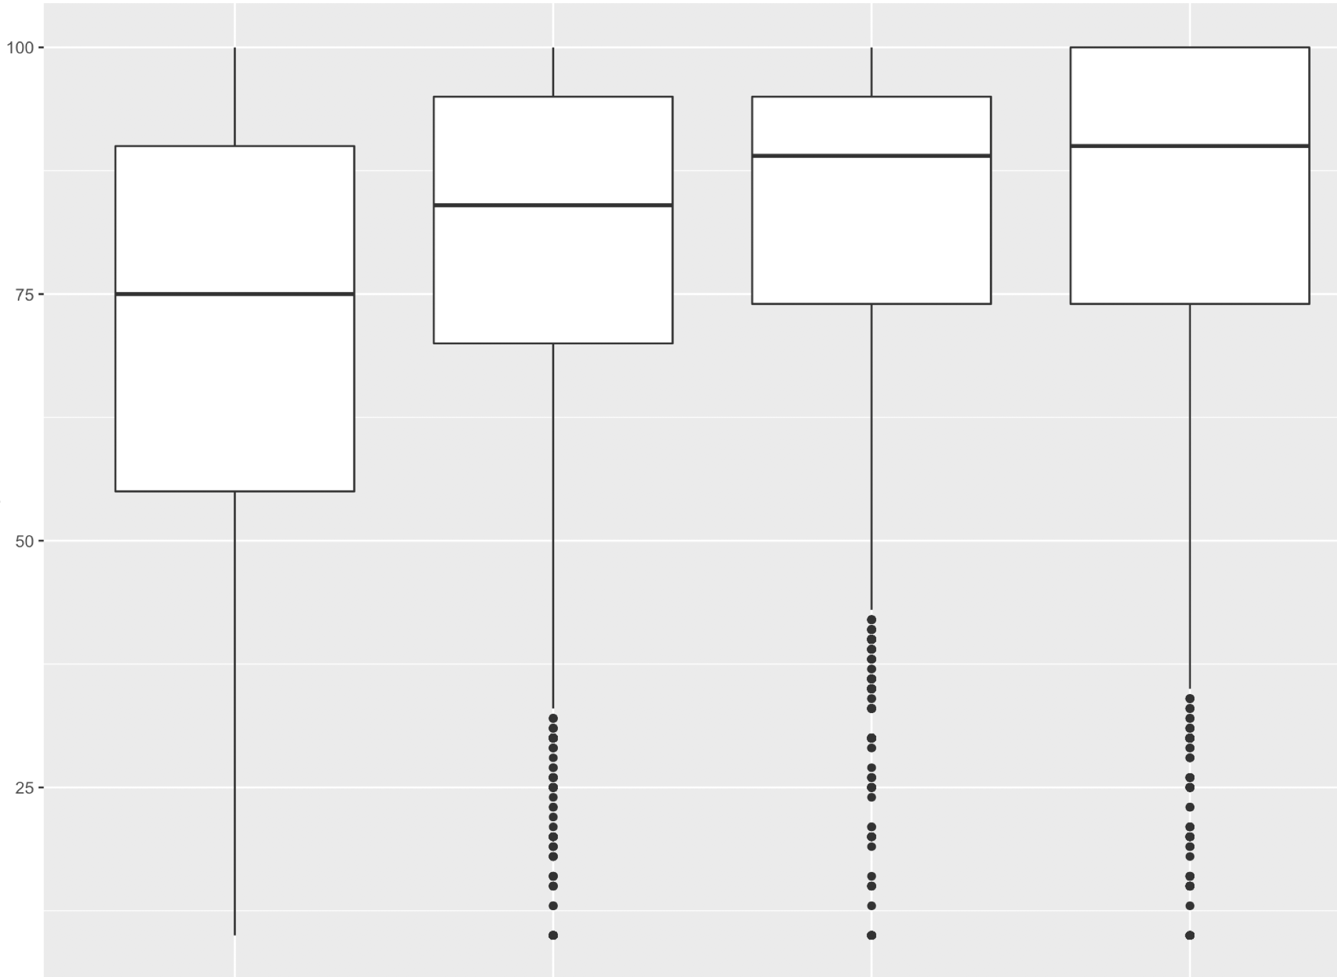
How worried are you right now about not being able to pay medical costs of a serious illness or accident?
Sleep Score
Very worried
Moderaterly worried
Not too worried
Not worried at all

Slide 18
Methods
Initial analysis involved exploring the association between sleep score and different factors (~60 variables)
Narrowed down to 23 variables based on the linear relationships with the sleep score
After plotting the residuals from the resultant model, the following variables were selected : PHSTAT: How would you describe your health in general? ASIMEDC: How worried are you right now about not being able to pay medical costs of a serious illness or accident? ASICNHC: How worried are you right now about not being able to pay medical costs for normal healthcare?
Notes:
Talk about RMSE of 18.83
Talk about narrowing down the variables using pvalues

Slide 19
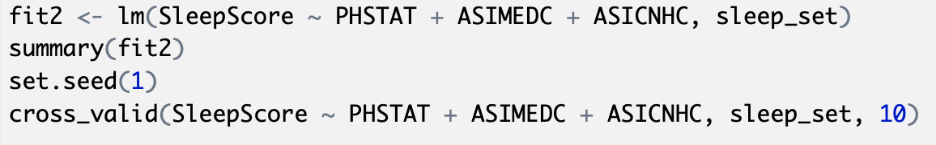
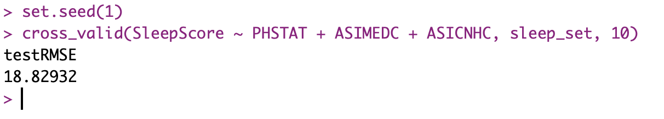
We fit a linear model to predict the Sleep-score
Used cross k fold validation on the dataset for the linear model fitted

Slide 20
CHALLENGES
Too many variables to check for the linearity
Many observations had missing values.
INTERESTING RESULTS
Married people sleep well!
More proportion of people with social security seem to be sleeping for unhealthy amount of hours!
Notes:
Talk about how NA values were added.
Only 12 observation had useful information for every variables of interest.

Slide 21
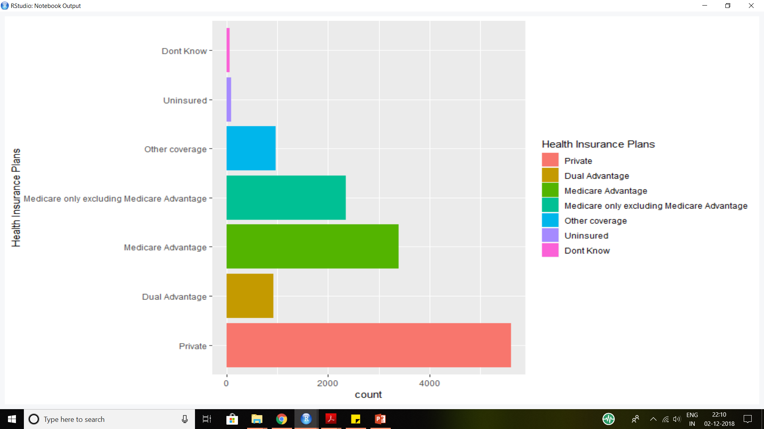
Health Insurance Plans

Slide 22
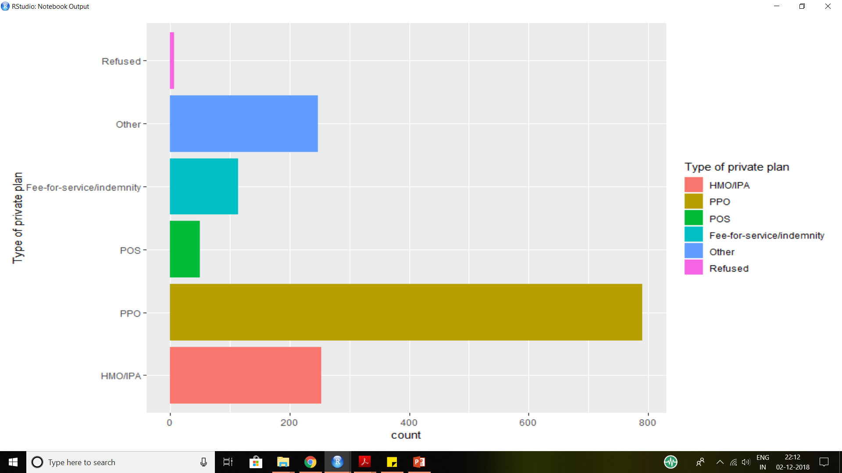
Type of Health Insurance Plans

Slide 23
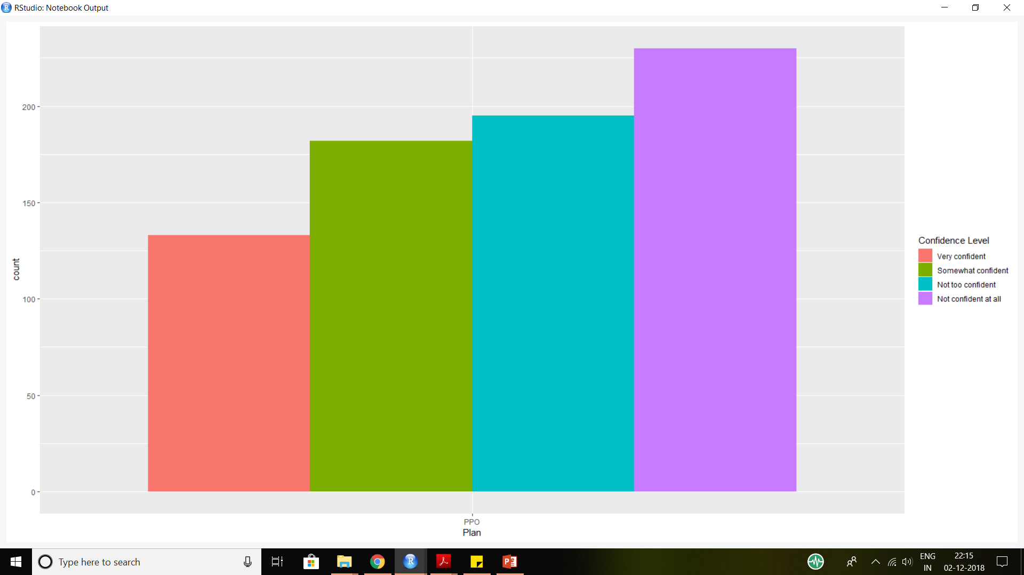
Confidence level of people with PPO plans while selecting affordable plans on their own

Slide 24
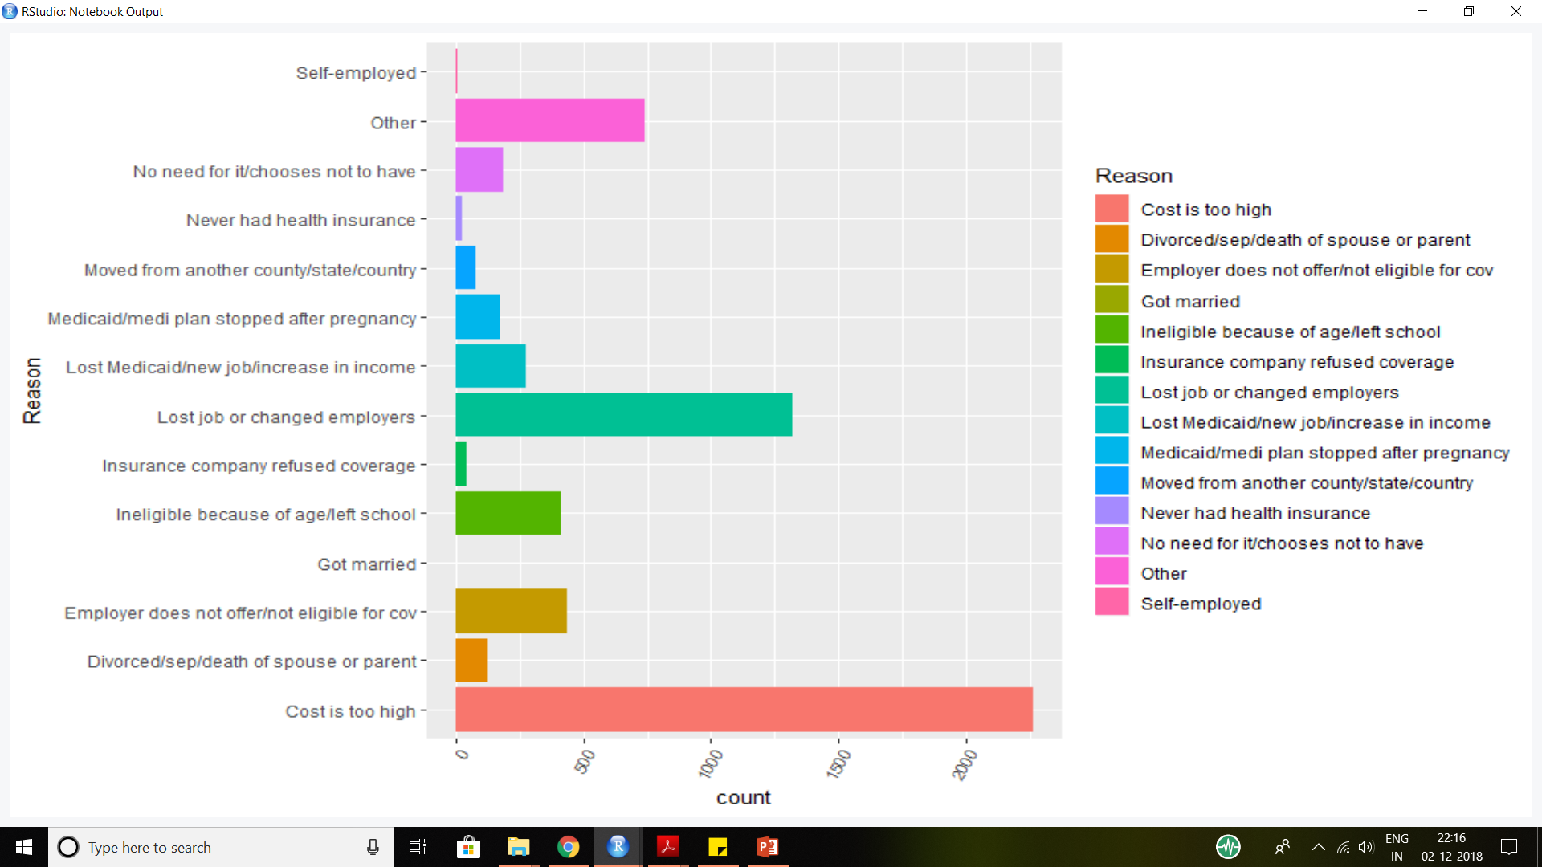
Reason for being uninsured.

Slide 25
VISION AND DENTAL CARE
Only 3% of the population below the age of 18 faces vision problem whereas 7% above the age of 18 faces the issue.
Below the age of 18, males face this issue more than females. Above the age of 18, females face this issue more than males.
Among the people facing the vision issues, the current status of more than 90% is chronic.
11% of the population could not afford dental care.
Change in healthcare plan didn’t affect the affordability of dental care / eye glasses.

Slide 26
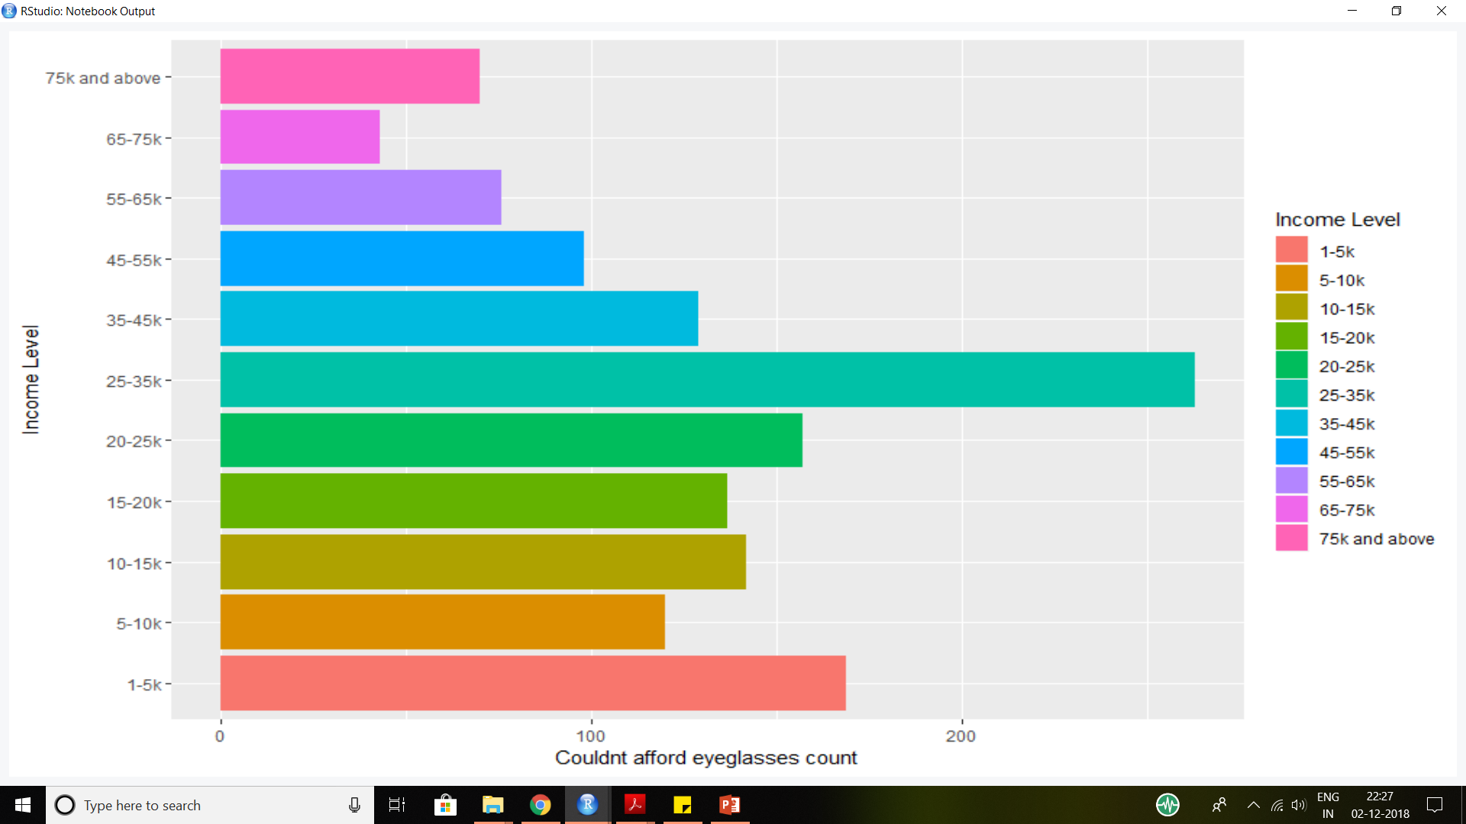
Unable to afford eyeglasses based on income levels

Slide 27
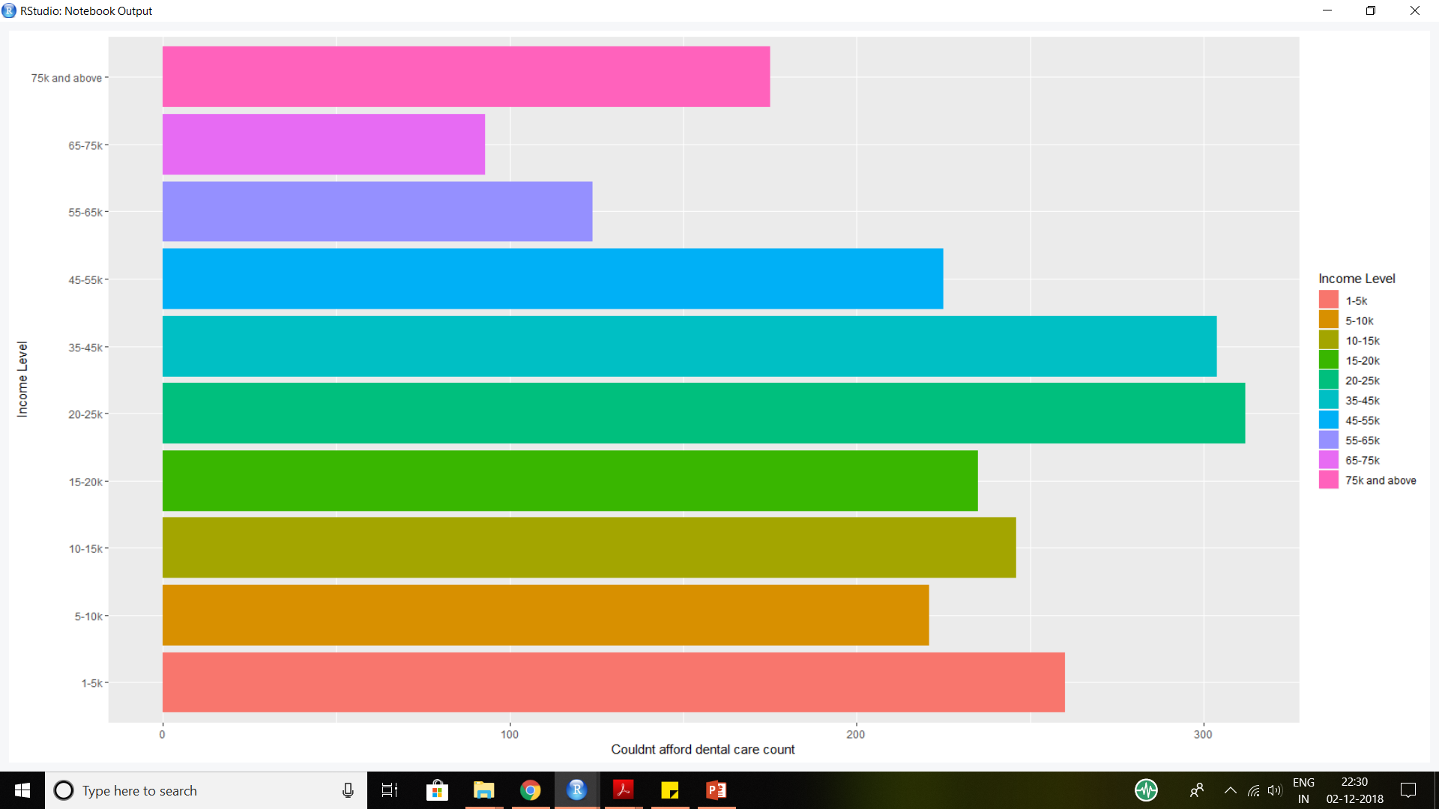
Unable to afford dental care based on income levels

Slide 28
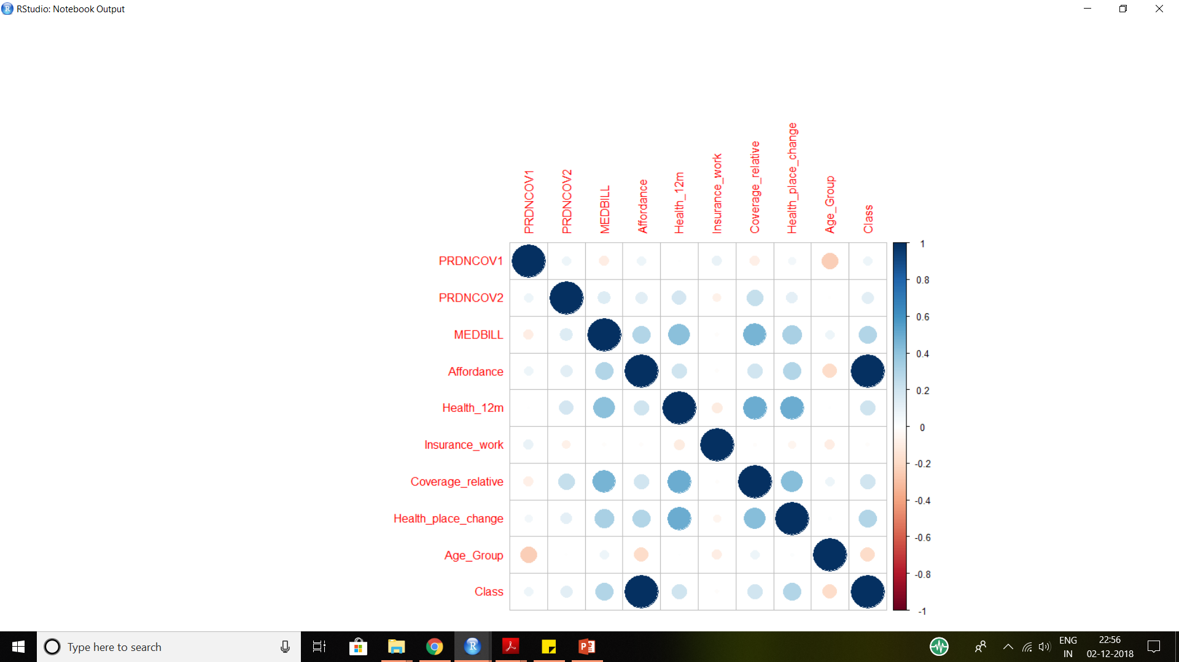
MODELLING
A new variable, called affordability
was defined where a score of 0 was given when a person couldn’t afford both dental care and eye glasses,
1 when he could afford either and 2
when both.

Slide 29
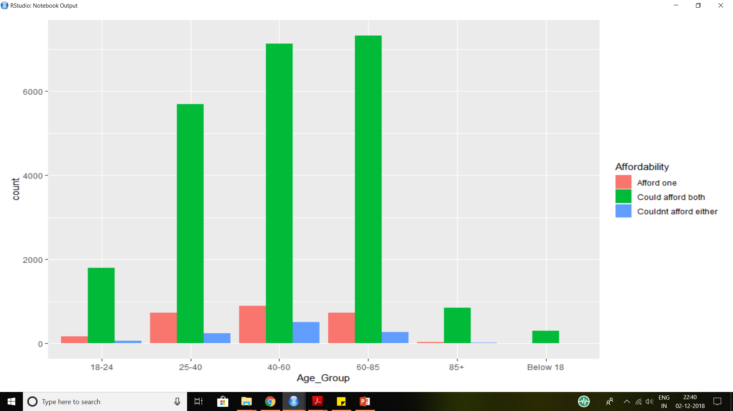
Affordability based on Age group.

Slide 30
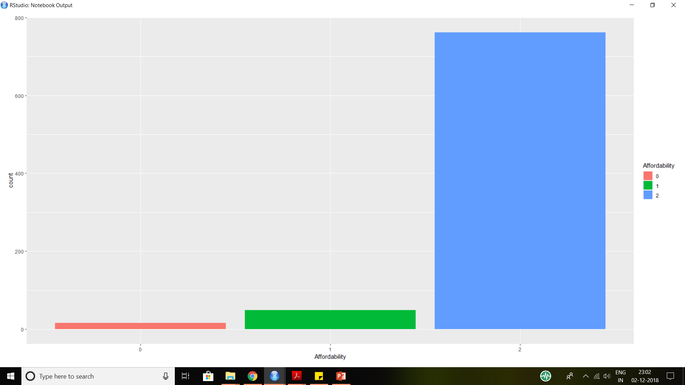
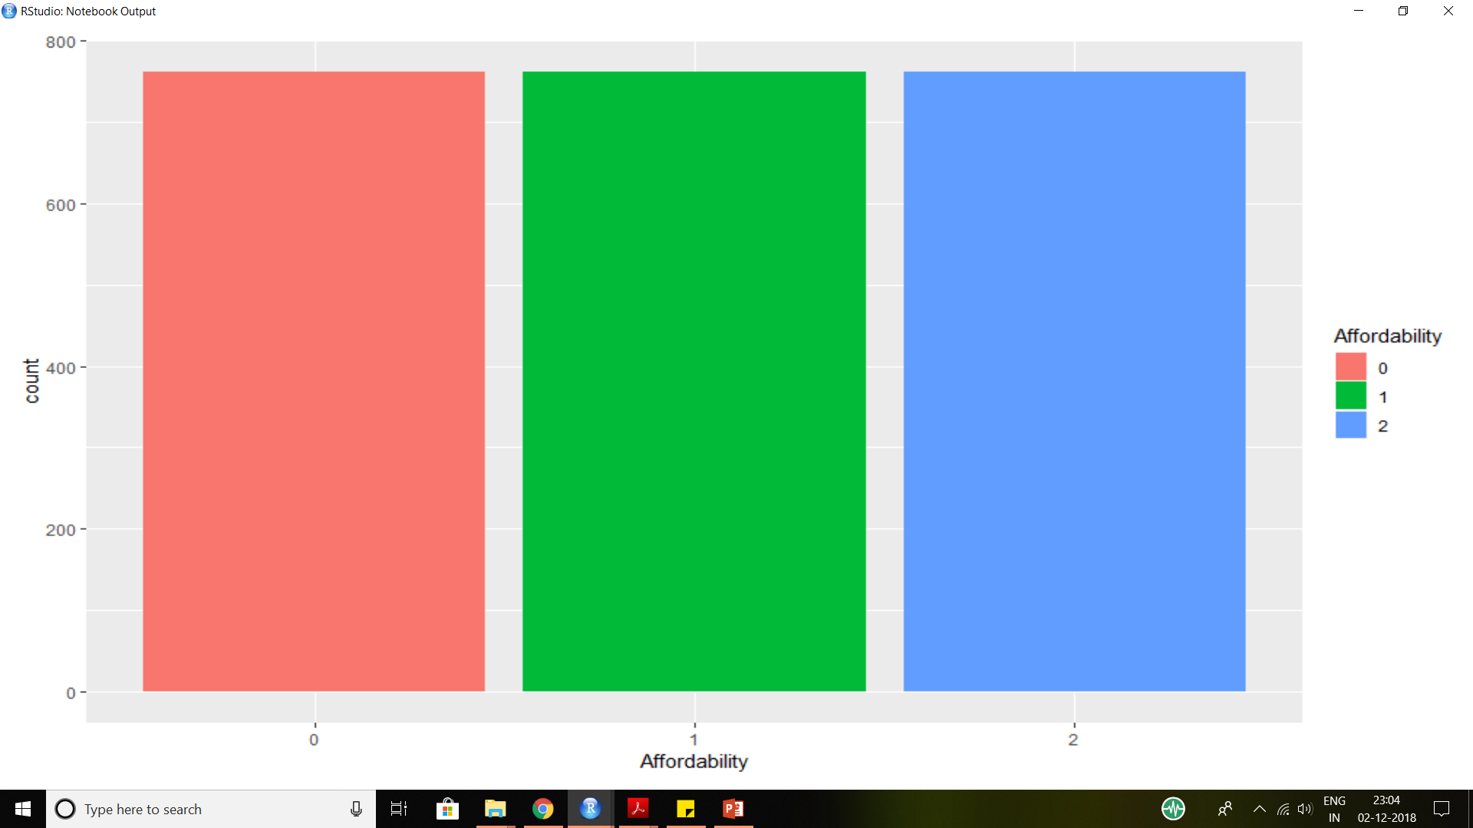
PROBLEM OF DATA IMBALANCE
Notes:
Mention challenges

Slide 31
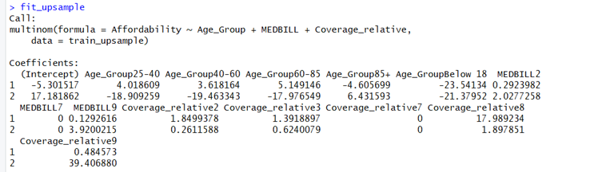
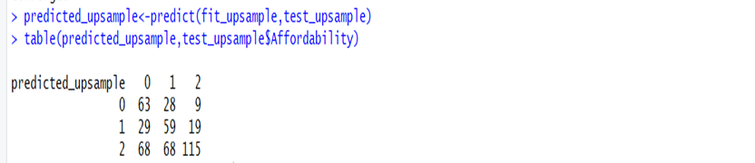
A multinomial logistic regression was run to classify affordability based on certain explanatory variables.

Slide 32
PROBLEM STATEMENT
A conversational tool that can help business owners to easily interact with the data and visualize it.
There have been many prototypes to translate natural text to query like syntaxes but never had the power to visualize data and do slicing and dicing that R libraries provide
This is an attempt to combine both natural language and the power of visualization.

Slide 33
Bot Architecture
Slack bot
Data Layer
Application Layer
Dialog flow

Slide 34
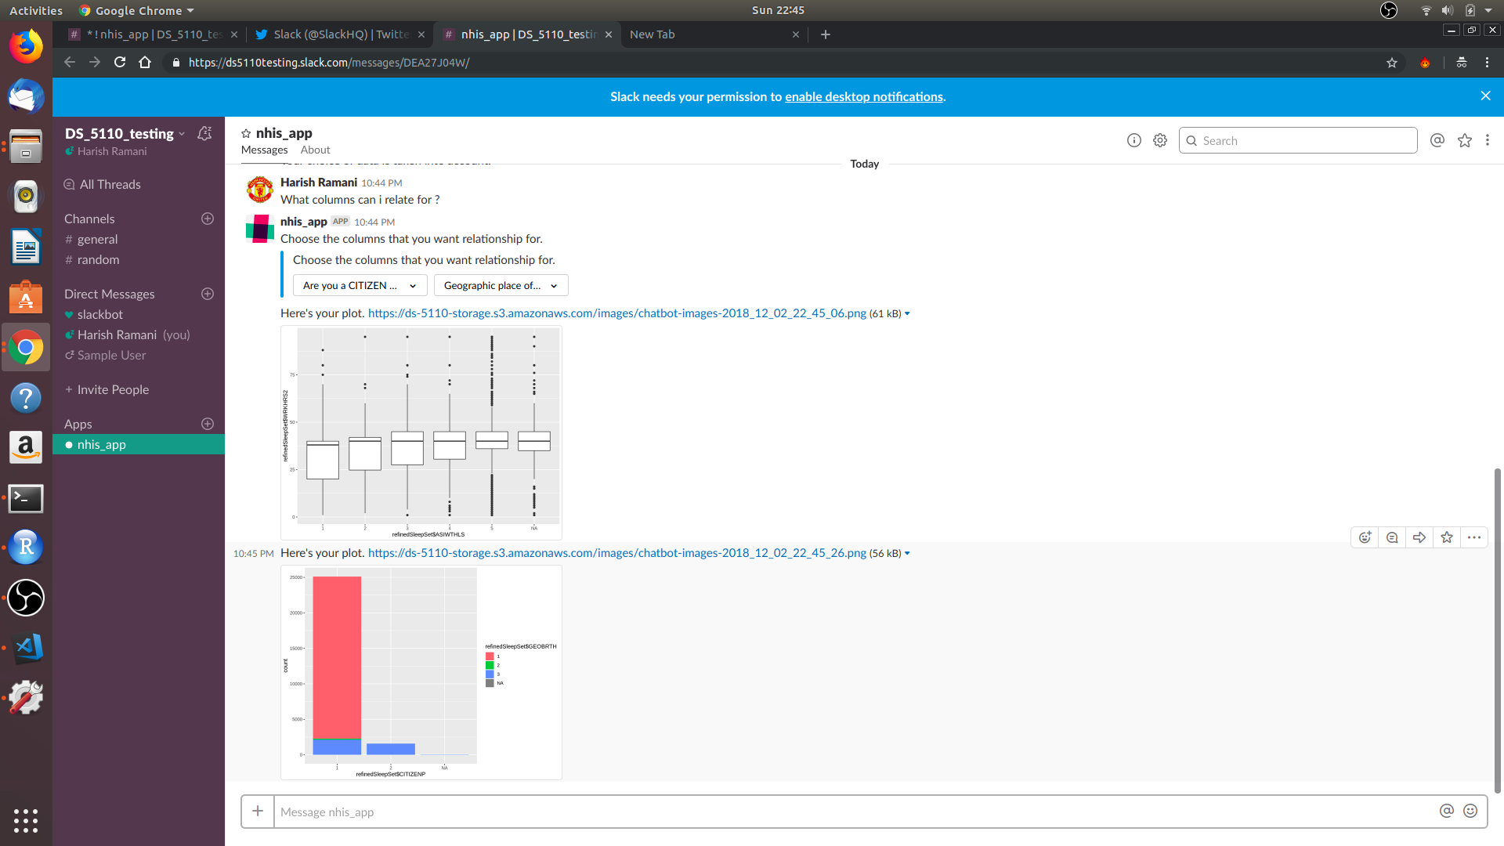

Slide 35
NHIS5110 R Package
A centralized way to combine individual analysis of the data
Created utility functions such as getting the metadata , computing the sleep scores
etc.
Exported the tidy data into the package

Slide 36
CHALLENGES
No structured way to collect and report data
Hence there is a disconnect between the codebook and the actual data.
Dialog flow has limitations in the the number of entities that can be created and for the synonyms associated with each entity

Slide 37
FURTHER SCOPE
A framework could be created that can be agreed upon by the entire data science community as to how we could gather data and report metadata.
This could help us in creating utility tools that can perform NLP on the metadata
A sample metadata file could look like:
{
Description of the entire data set
Corpus set of tags defining the data set
Description for individual columns
Tags describing the columns which is a subset from corpus
}

Slide 38
Resources
Chat Bot Demo
R Package
Chat Bot
Raw Data set

Slide 39
QUESTIONS ?

